Slide 1
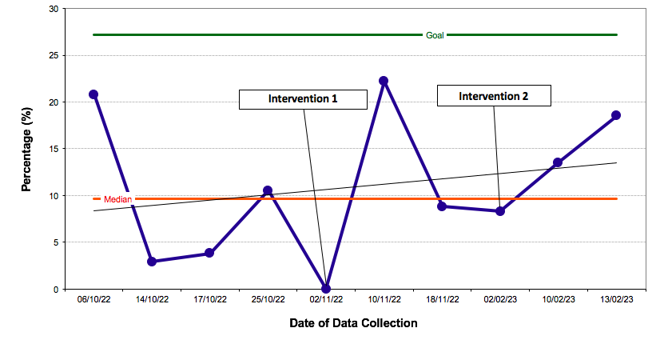
Keep Calm and Stay Warm:
A QI Project to Optimise Perioperative Temperature Control in Paediatric Anaesthetics at the Evelina London Children’s Hospital
Alokya Balagamage¹, Angela Huang¹, Christy Vougioulki¹, Aman Patel¹, Dr. Katy Nicholson²
¹GKT School of Medical Education, King’s College London ²Evelina London Children’s Hospital, Guy’s and St. Thomas’ NHS Foundation Trust
INTRODUCTION
RESULTS
DISCUSSION AND CONCLUSIONS
Hypothermia is a core body temperature below 36˚C¹. As anaesthetic drugs impair hypothalamic thermoregulation, complications of heat loss include delayed recovery and increased risk of surgical wound infection². Predominantly owing to a smaller weight-to-surface-area ratio, this is more common in paediatrics³ with 45.1% of cases involving at least one hypothermic episode⁴. It is therefore vital that body temperature is regularly monitored and corrected throughout the perioperative period.
AIM: To increase the percentage of anaesthetic charts with temperatures taken and documented at the correct time intervals according to the Evelina guidelines for perioperative temperature control by 20 by mid-February 2023.
Our results indicate that reminder based interventions can be effective for improving guideline compliance. However, we did not reach our aim. In response to a questionnaire distributed to the team, 75% (n=3) indicated the interventions provided useful reminders of forgotten information while 56% (n=5) were absent from the presentation. Staff engagement should hence be prioritised. Further PDSA cycles may reiterate the guidelines by other means (e.g. by attaching to anaesthetic desks) to sustain improvement and enhance safety. Electronic prompts which signal when recordings are to be made could also be considered.
REFERENCES
METHODS
Figure 1: A run chart showing the percentage of anaesthetic charts with correctly recorded temperature measurements in accordance with the Evelina guidelines for perioperative temperature control and the effect of our interventions. Also shown is the median = 7.5% (orange), our goal = 27.5% (green), an upward trend line (grey) and indicators for when the interventions were introduced (1: 02/11/22, 2: 02/02/23).
Hart, SR, Bordes, B, Hart, J, Corsino, D, Harmon, D. Unintended Perioperative Hypothermia. The Ochsner Journal 2011; 11:259-270
Diaz, M, Becker, DE. Thermoregulation: Physiological and Clinical Considerations During Sedation and General Anesthesia. Anesth Prog 2010; 57:25-33
Nemeth, M, Miller, C, Bräuer, A. Perioperative Hypothermia in Children. Int. J. Environ. Res. Public Health 2021;18:7541
Görges, M, Afshar, K, West, N, Pi, S, Bedford, J, Whyte, SD. Integrating Intraoperative Physiology Data Into Outcome Analysis for the ACS Pediatric National Surgical Quality Improvement Program. Pediatric Anesthesia 2019;29(1):27-37
An initial patient shadowing exercise enabled us to observe how temperature measurements are recorded in practice. Two Plan, Do, Study, Act (PDSA) cycles were subsequently completed:
PDSA Cycle 1:
Delivered a presentation to the paediatric anaesthetic team on the importance of and current local guidelines for perioperative temperature control
Data was collected over an 18-week period
Baseline recording accuracy: 8.4%
Accuracy post-PDSA cycle 1: 8.8%
Accuracy post-PDSA cycle 2: 13.6%
A 5.2% increase in correct documentation was noted overall.
ACKNOWLEDGEMENTS
PDSA Cycle 2:
Displayed posters containing key points from the guidelines and results from PDSA cycle 1 as an incentive for improving performance
The group would firstly like to thank our supervisor Dr. Katy Nicholson for all the support and advice that was given during this project. We are also grateful to the paediatric anaesthetic team at the Evelina London for taking the time to listen to our presentation, view the posters and provide responses to our questionnaire.

